Slide 1
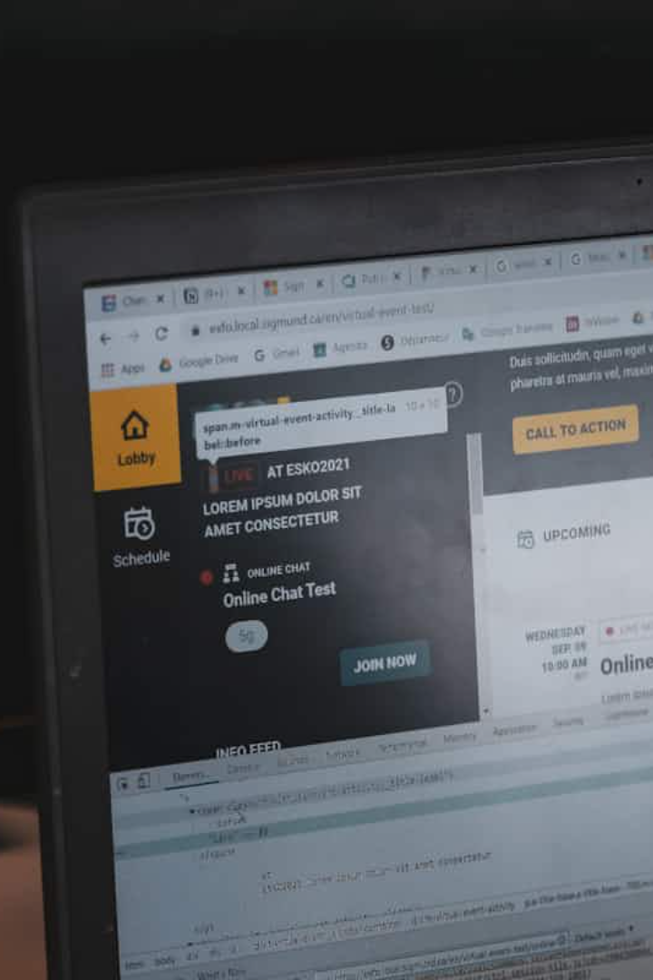

Java I/O and Streams: A Comprehensive Guide
This presentation will explore the fundamentals of Java streams, covering byte streams, character streams, console I/O, and file I/O.
by Samyog Khadka

Slide 2

Streams
Streams Represent a sequence of data or data that can be processed sequentially.
Java streams are used for reading and writing data, enabling efficient data handling in a program.
They support both binary and text data.
Definition
Java provides a rich set of I/O streams to perform input and output operations.
Streams are divided into two categories:
1. Byte Streams 2. Character Streams

Slide 3
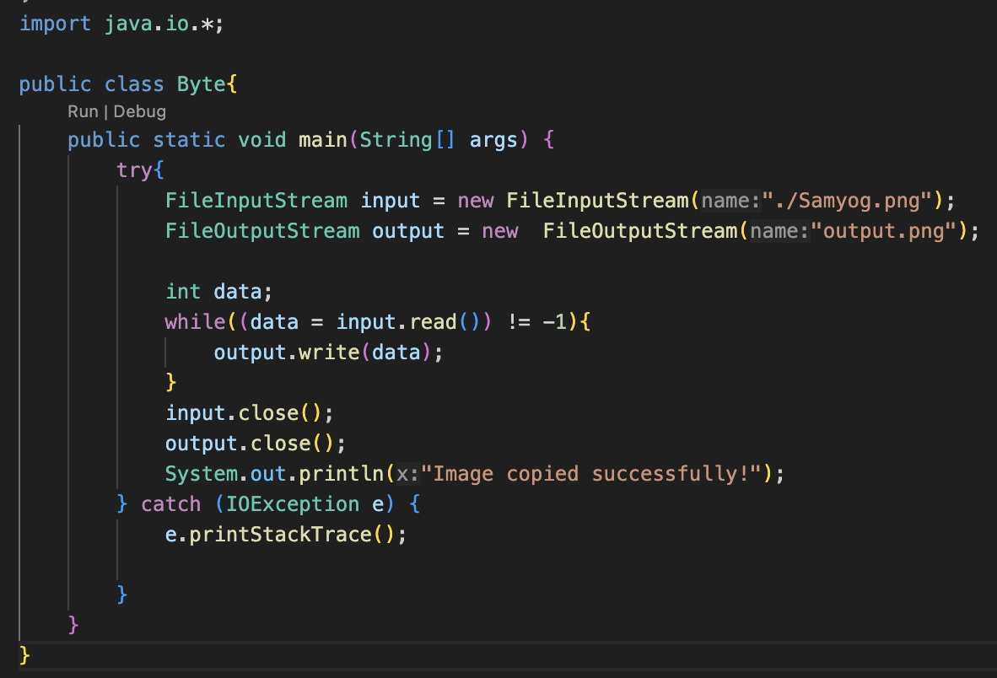
Byte Streams: Handling Binary Data
EG. Copying an image
Definition
Byte streams work with raw binary data, ideal for files like images, audio, and video.
Key Classes
InputStream (abstract)
FileInputStream
ByteArrayInputStream
OutputStream (abstract)
FileOutputStream
ByteArrayOutputStream

Slide 4
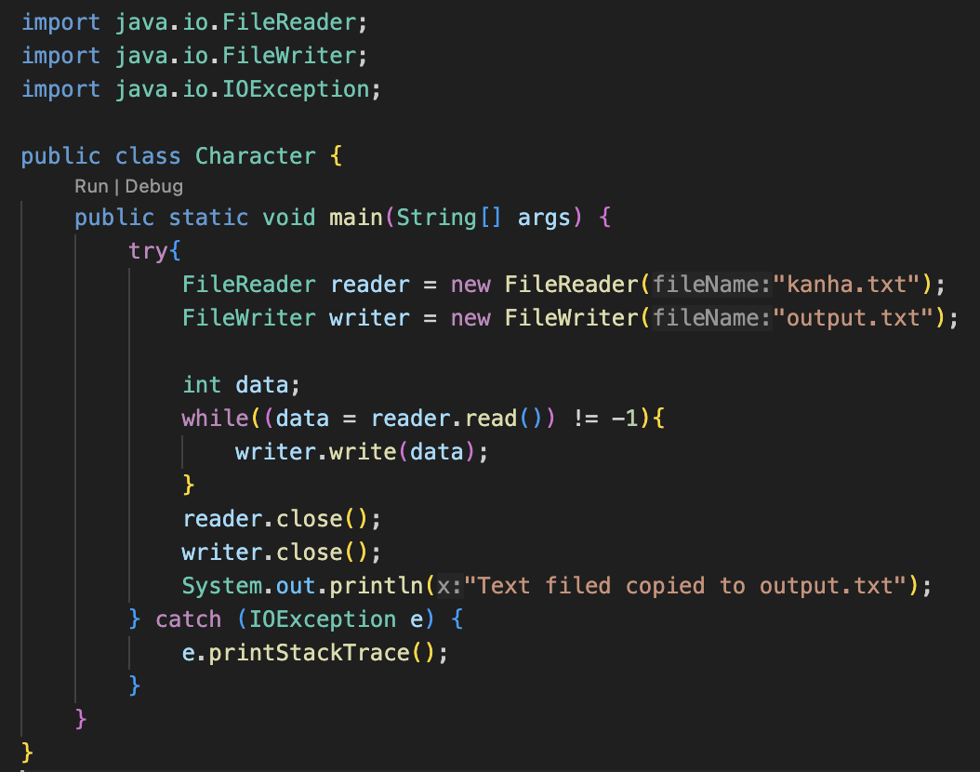
Character Streams: Working with Text
EG. Copying a text file
Definition
Character streams handle text data, suitable for files containing characters or strings.
Key Classes
Reader (abstract)
FileReader
BufferedReader
Writer (abstract)
FileWriter
BufferedWriter

Slide 5
Byte Streams vs. Character Streams
Aspect
Byte Streams
Character Streams
Data Type
Binary data
Text data
Classes
InputStream, OutputStream
Reader, Writer
Usage
Media files (images, videos)
Text files
Efficiency
Efficient for binary data
Better for text processing
Encoding No encoding/decoding Handles character encoding
involved

Slide 6

Best Fit Scenarios
Byte Streams
Character Streams
Handling Binary data.
If working with binary files / non-text files (e.g., audio, video, images) or raw data: Use Byte Stream.
Handling text data.
If working with text files or
data requiring encoding:
Use Character Stream.

Slide 7
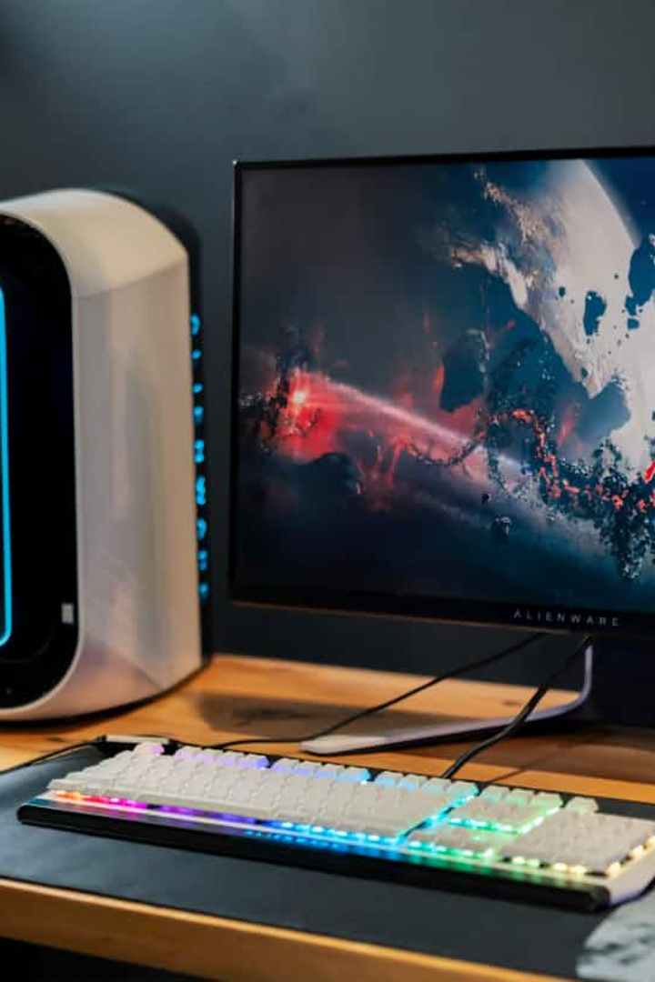
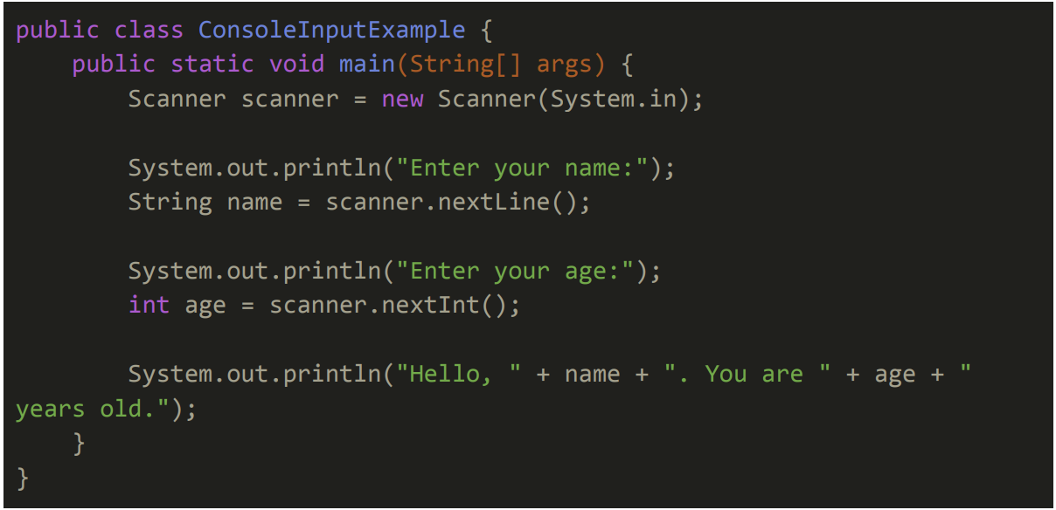
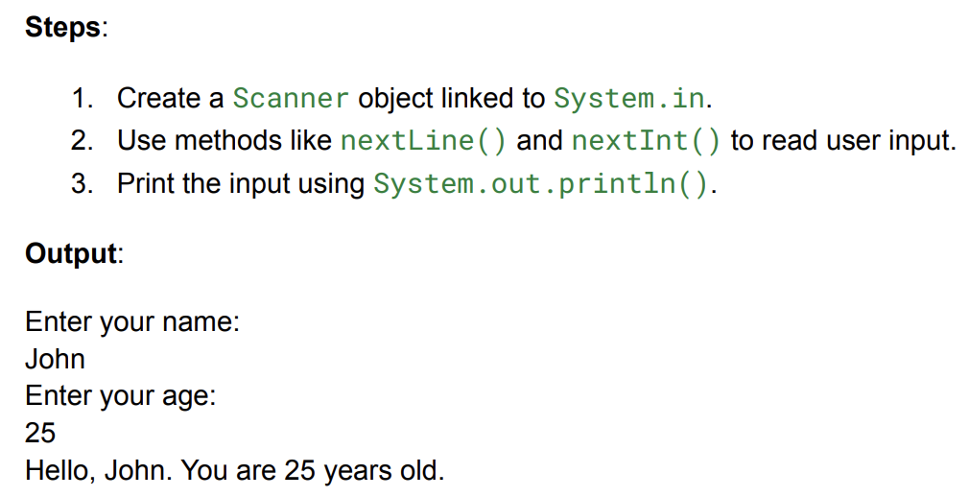
Console Input/Output
1
Reading Input
2
Writing Output
Use Scanner or BufferedReader to read console input.
Use System.out.println() to display output on the console.

Slide 8
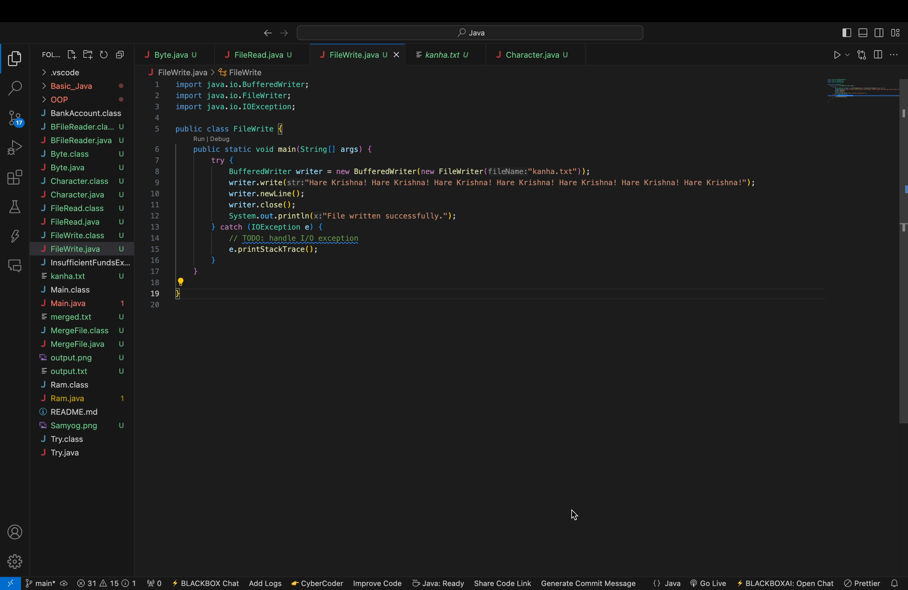
File I/O: Reading and Writing Files
Reading Files
Use BufferedReader for efficient file reading, reading line by line.
By embedding FileReader into BufferedReader, you get both character-level access and efficient, buffered line-by-line processing.
Writing Files
Use BufferedWriter to write data to a file.

Slide 9
Some main pros of using streams in I/O
Abstraction: Provides a unified interface for handling various data sources (files, network, memory).
Flexibility: Supports both binary (byte streams) and text (character streams) data.
Performance: Buffered streams improve efficiency by minimizing direct I/O operations.
Encoding Support: Character streams handle text encoding seamlessly for internationalization.

Slide 10
Key Takeaways
1. Streams
Byte streams for binary data/files, character streams for text based files.
2. Console I/O
Scanner for input, System.out for output.
3. File I/O
BufferedReader and BufferedWriter for efficient file operations.

Slide 11

Any Queries?

Slide 12

ThankYou,
for your
Co-operation.

